Slide 1
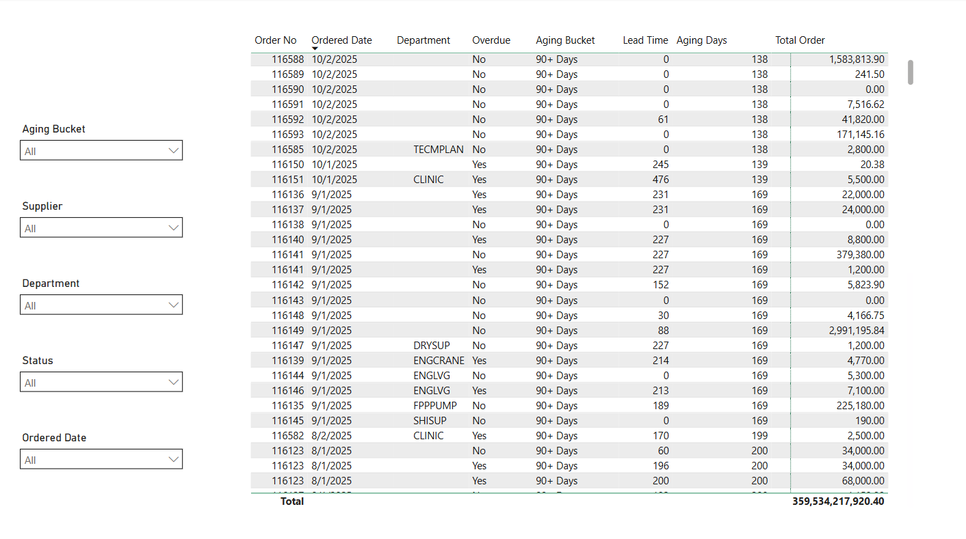

Order No
Date
Department
Overdue
Aging Bucket
Lead Time
Aging Days
Total Order

